Slide 1
Introduction
Prof. Dr. Zahid Halim

Slide 2
Instructor
Email: zahid.halim@giki.edu.pk
Faculty of Computer Science and Engineering
Office: G-05
Office Hours:
Wednesday/Thursday 9:00 a.m. - 12:00 noon.

Slide 3
Course TA
Ms. Khadija Akbar Shah
Never hesitate to contact TA or me whenever you have some problem

Slide 4
Some Rules
There is only one rule that will make the rest of the rules
  Raise your hand before asking any question and then WAIT for the permission
  Never ever miss a class
  Never ever “sleep” in the class
  Never even think to use mobile phones in the class
  Always communicate in the official communication language

Slide 5
Books
  Paul J. Deitel and Harvey M. Dietel, “ C++20 for Programmers ”, 9th Edition, Deitel & Associates, Inc. (2022)
  Dietal and Dietal, “How to Program C++”, 3rd Edition

Slide 6
Dishonesty, Plagiarism in Quizzes, Assignments
All individuals involved in any kind of cheating in any exam, quiz, assignment or project will get -50% score.

Slide 7
Attendance
Students are required to attend 100% classes of courses registered and can not abstain from even a single class.
For circumstances beyond their control, students must apply for leave on prescribed Leave Application form.

Slide 8
Tentative Evaluation Breakdown
Assignments (6) | 15
Quizzes (6) | 10
Term Project (1) 2 Phases | 15
Midterm (1) | 20
Final (1) | 40
Total | 100

Slide 9
Course Execution
3 lectures of one hour every week
1 lab of three hours every week, CS112L
Mind it: Lecture scheduling is to be done by the Dir. (A&E). Please avoid visiting me for any clashes

Slide 10
Notes
Course contents and their order may be slightly modified during the course execution.
No make up for missed quizzes or assignments/homeworks
Deadline for assignments and projects are always final.
Quizzes may be announced or un-announced
Serious action will be taken for any kind of cheating
MS Visual Studio will be used for console programming
All assignments and project will be on individual bases
Same number of quizzes and assignment will be in lab as in course
Mid and Final exam of lab will be conducted on compiler

Slide 11
Course Outline
Week 1 | User defined data types, Structures, Unions and Enumerations
Week 2 | Recursion, Preprocessing in C++
Week 3 | Bit Manipulation, Strings, Pointers
Week 4 | Reference and Dynamic memory allocation
Week 5 | Function Pointers, ADTs and C++ Classes-I
Week 6 | C++ Classes-II Constructor, Destructor, Copy Constructor
Week 7 | Inheritance, Virtual Functions and Polymorphism
Week 8 | Operator Overloading, Function and class templates
Week 9 | Exception Handling
Week 10 | I/O Streams and File Handling
Week 11 | Graphics
Week 12 | GUI Programming
Week 13 | Introduction to Standard Template Library
Week 14 | Scripting and Markup languages

Slide 12
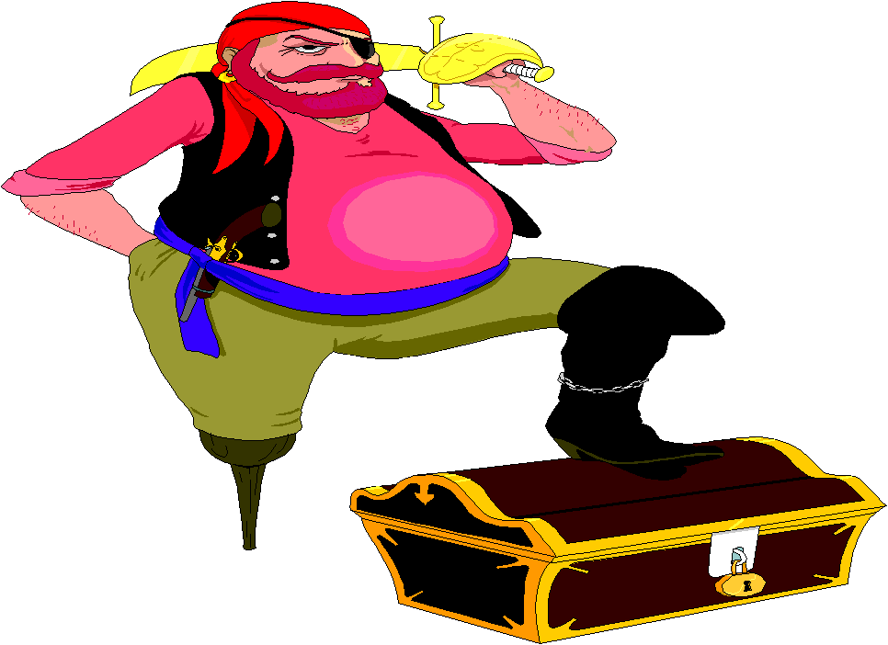
Motivation
Only 1 programming course out of approx. 40 courses
Core of core of computer science
Excellent Programming = Excellent chances of good job
Remember practice makes a person “perfect”.
  Same goes for programming.

Slide 13
Structure
A Structure is a container, it can hold a bunch of things.
  These things can be of any type.
Structures are used to organize related data (variables) into a nice neat package.

